Slide 1
Triads in Second Inversion
MUS 213 – October 3, 2016

Slide 2
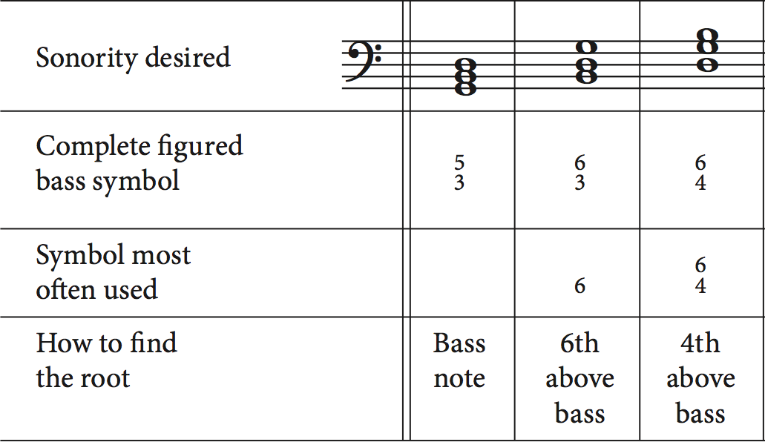
Review: First Inversion Triads
Third of the chord is in the bass voice
Uses:
As a substitute for root position triads
Improve contour of bass line
Lessen weight of V and I chords
Occur incidentally through an arpeggiated bass
Sometime occur in a series of parallel sixth chords

Slide 3
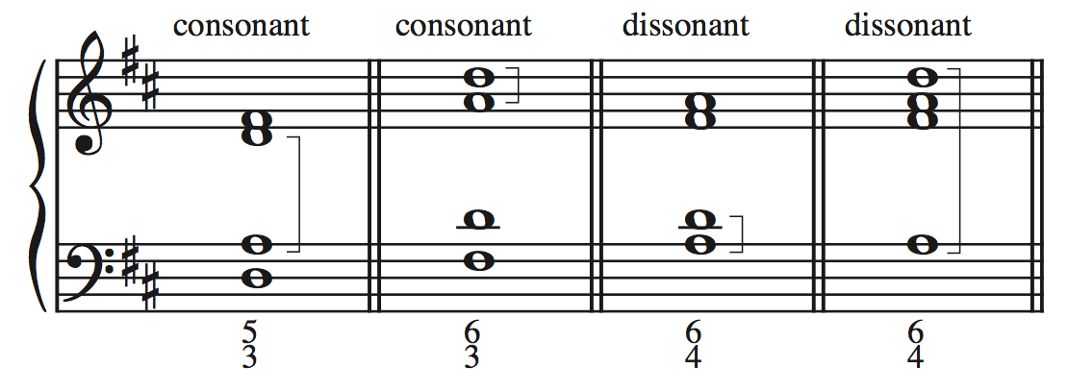
Triads in Second Inversion
Fifth of the chord is in the bass voice
Not used as substitutions for root positions chord
Unstable sonority
P4 interval with the bass voice is a dissonance

Slide 4
Uses of Second Inversion Triads
As second inversion triads are more unstable than root and first inversion chords. Our uses of them in tonal-stlye writing are restricted to:
Incidental Use
Arpeggiatied Bass
Melodic Bass
Stereotypical Use
Cadential Six-Four
Passing Six-Four
Pedal Six-Four

Slide 5
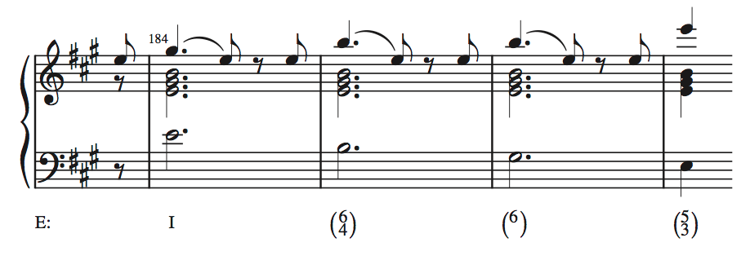
Bass Arpeggiation
Just as with first inversion triads, second inversion triads can incidentally occur when the bass voice is arpeggiating.
You need to decide if the chord is functioning as a six-four chord by taking into account metric placement, duration, and register.

Slide 6

Mahler: Symphony No. 1, III

Slide 7
Melodic Bass
If the bass part has an important melodic line it longer acts in its typical supporting. In this case many types of inversions can occur.
We stop hearing the bass voice as the harmonic foundation of the music.

Slide 8
Beethoven: Symphony No.3, I

Slide 9
Beethoven, op. 59, no. 1

Slide 10
Part-Writing Six-Four Chords
Four-part texture
bass (5th of the chord) should be doubled. Exceptions to this are rarely encountered in tonal music.
other voices move as smoothly as possible (often by step) both into and out of the six-four chord.
Three-part texture
all members of the triad
sometimes the root or 3rd is omitted, in which case the 5th is doubled

Slide 11
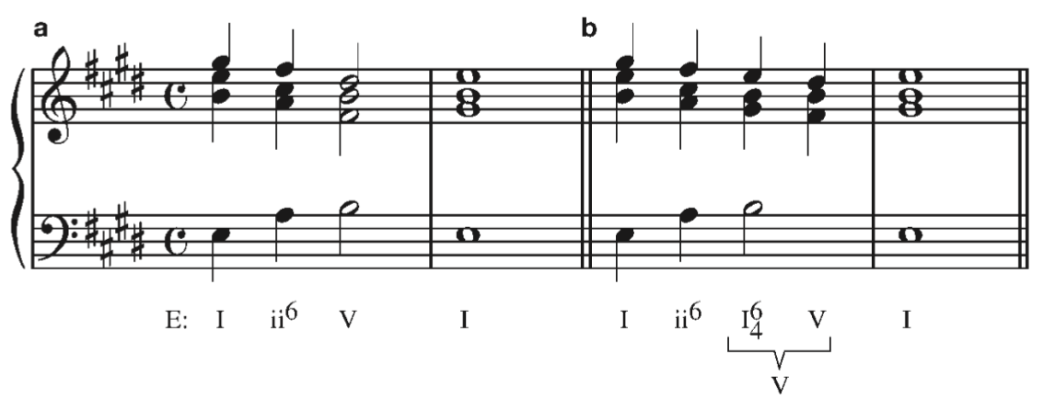
The Cadential Six-Four
Tonic six-four that delays the arrival of the V chord
It is followed by a V chord
Does not function as a tonic chord

Slide 12
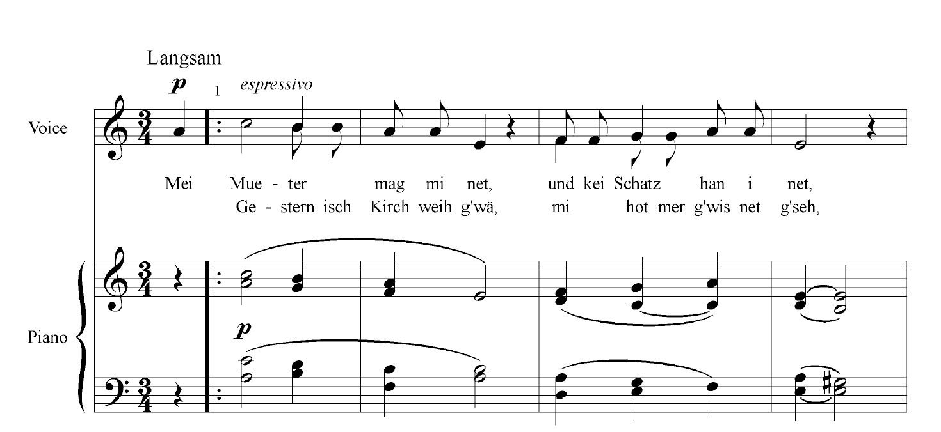
Brahms, "Die Trauerende", op. 7 no. 5

Slide 13
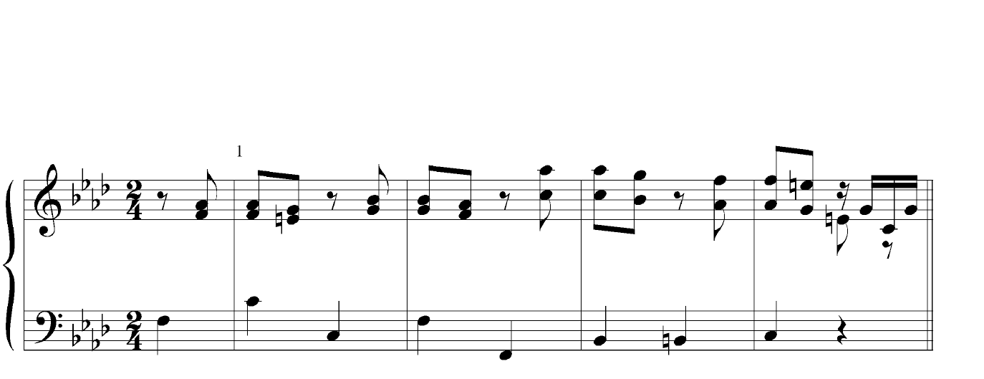
Bach, Well-Tempered Clavier, Book II, Prelude in f minor

Slide 14
Six-Four Chords (so far…)
TYPE | Function | Chord
Incidental (Melodic & Bass Arpeggiation) | N/A | Any Chord
Cadential Six-Four | Dominant | Tonic

Slide 15
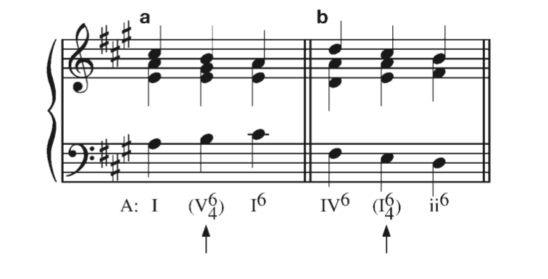
The Passing Six-Four
Second inversion that harmonizing the middle note of a three-note scalar figure in the bass.
Usually falls on a weak beat
Features smooth voice-leading
(indicate by placing roman numeral in parentheses)
VOICE EXCHANGE
PARALLEL SIXTHS

Slide 16
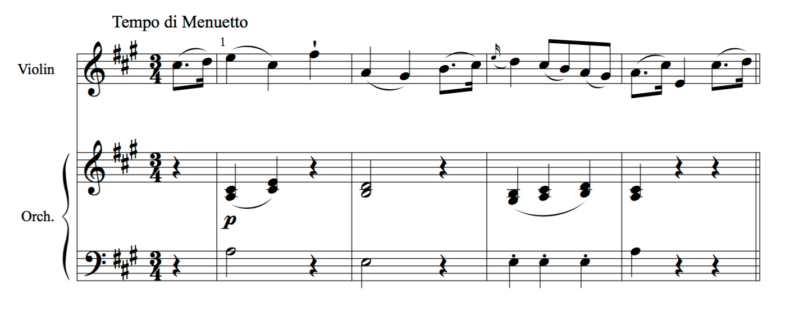
Mozart, Violin Concerto no. 5 in A Major, K. 219, mvt. 3, mm. 1-4

Slide 17
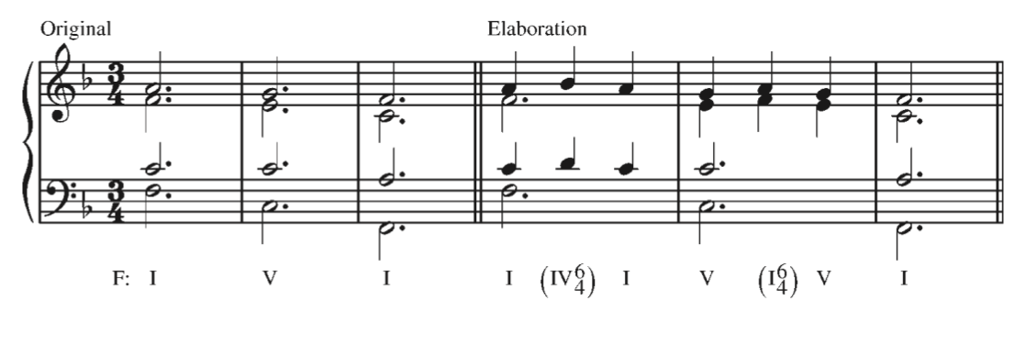
The Pedal Six-Four
One way of elaborating a static root position triad is to move the 3rd and 5th of the triad up by step and then back down by step to their original positions.
This is a technique to prolong a harmonic function

Slide 18
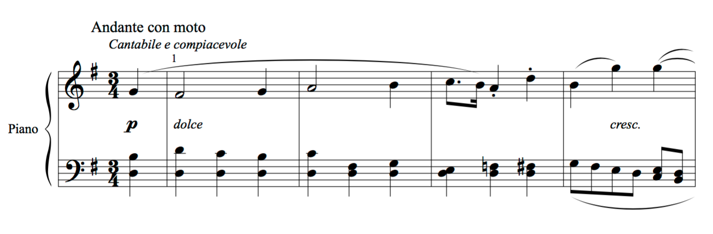
Beethoven, Bagatelle, op. 126 no. 1

Slide 19
Six-Four Chords (so far…)
TYPE | Harmonic Function | Chord | Purpose
Incidental (Melodic & Bass Arpeggiation) | N/A | Any Chord | -N/A
Cadential Six-Four | Dominant | I (i) | -Prolong the Dominant
Passing Six-Four | N/A | Any Common: I (i) & IV (iv) | -Harmonize scalar bass figures -Voice Exchange
Pedal Six-Four | N/A |  | -Prolong a root position triad

Slide 20
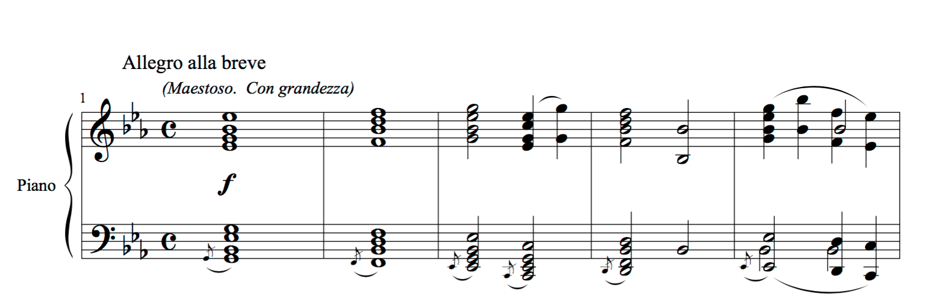
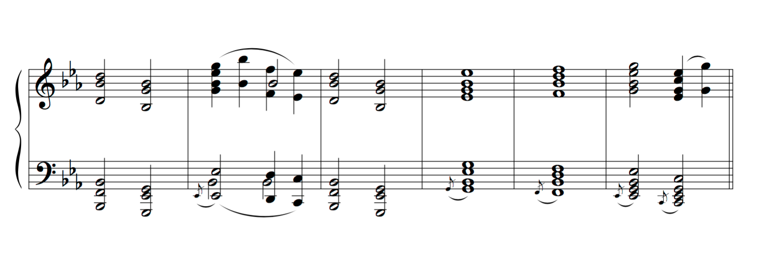
No class on Monday
Mussorgsky, Pictures at an Exhibition, "The Great Gate of Kiev”

